Slide 1
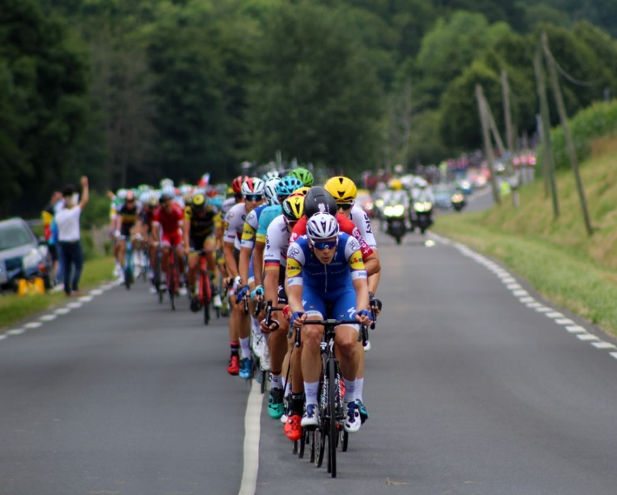
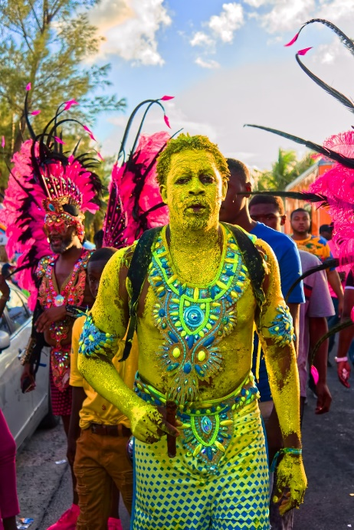
Conversation Class
Lunar New Year
Christopher bAUMAN

Slide 2
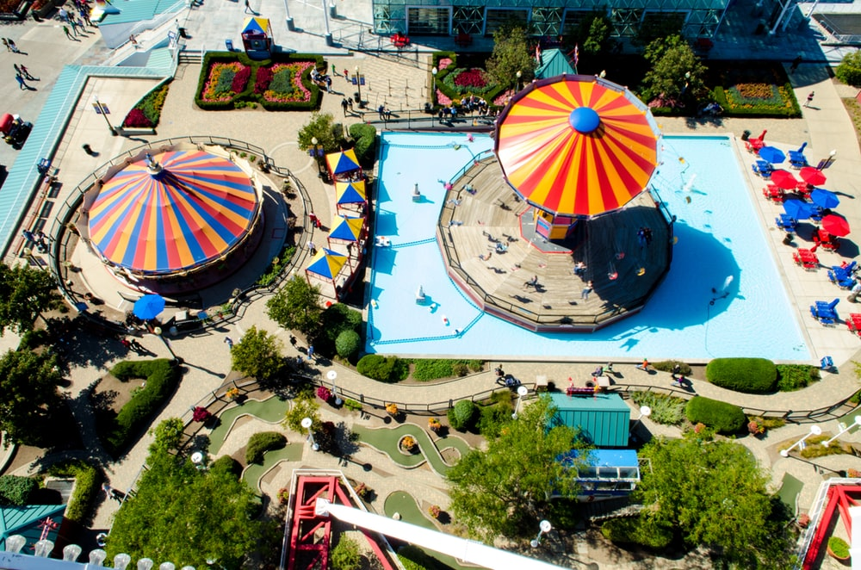
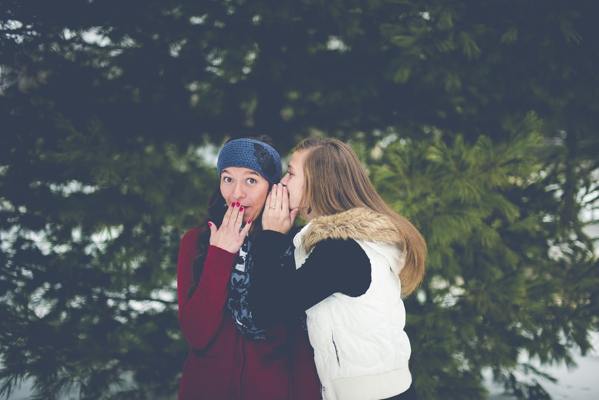
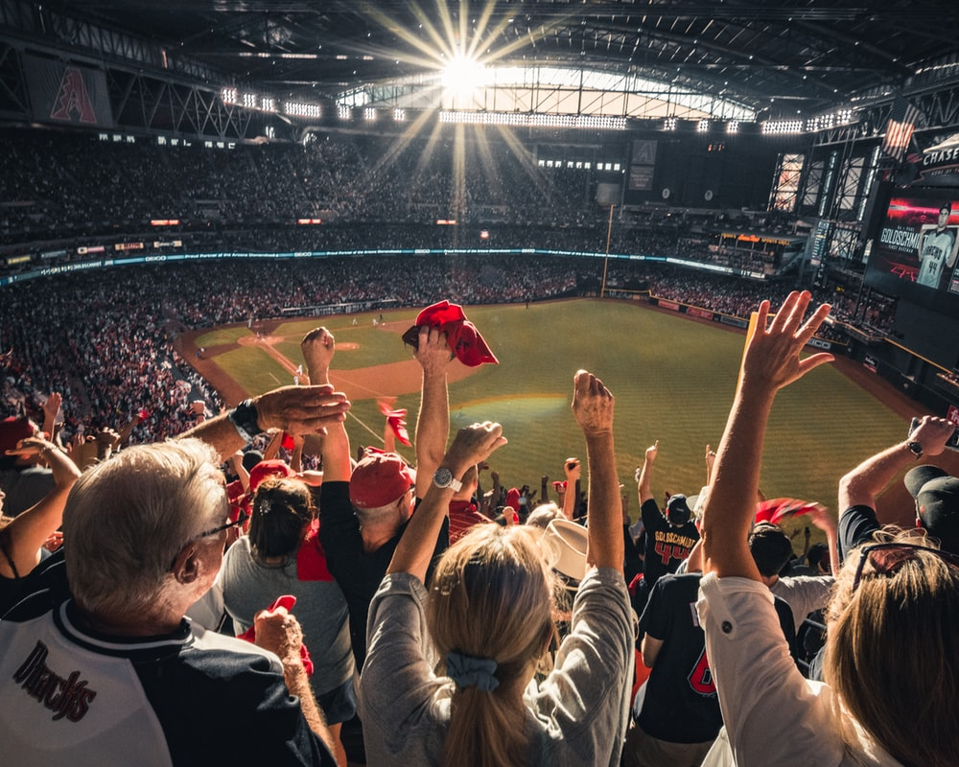
Education Infographic
Spare of the moment
Go with the flow
Off hand
Teachers
Education
Skills
Chris Bauman

